Slide 1
Panda Run
By narcis-Andrei tataranu

Slide 2

Temporary game website design
Figure 1.0 Game website

Slide 3
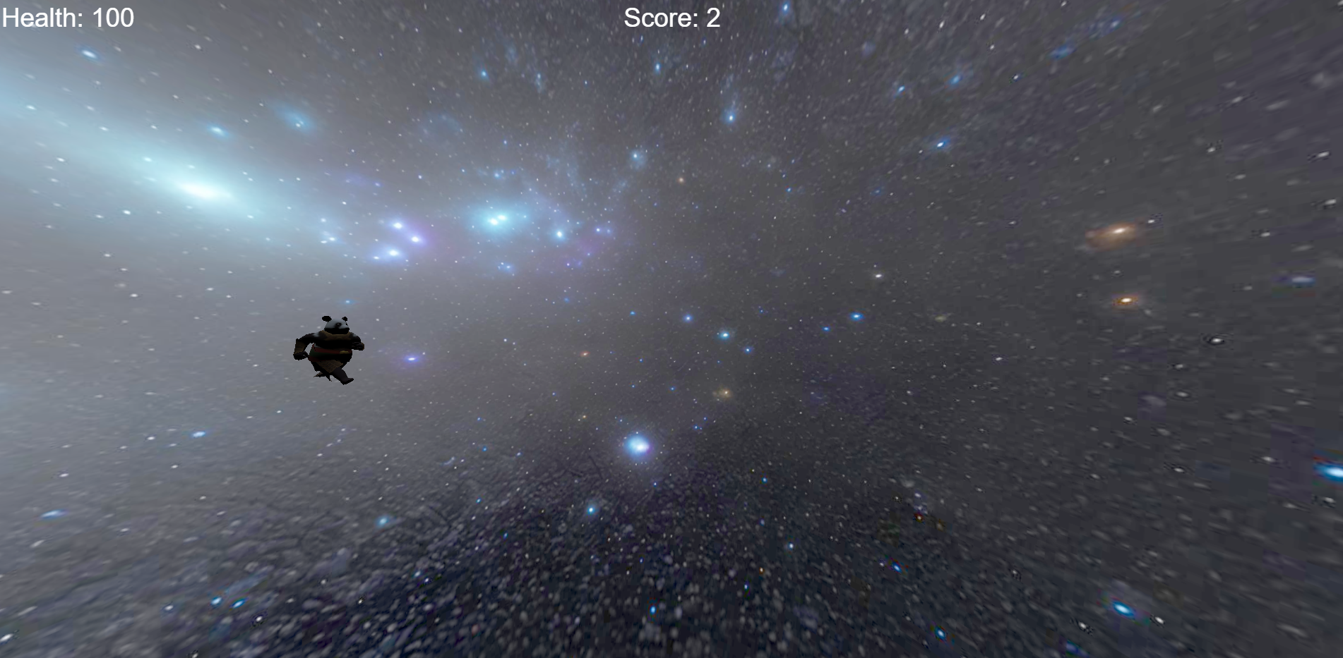
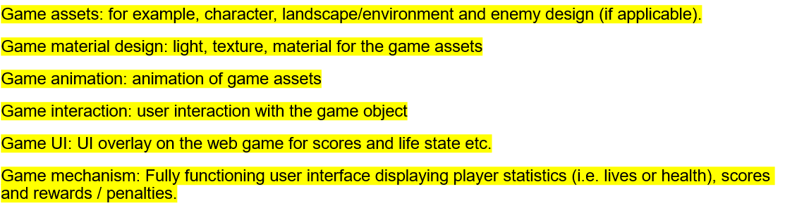
Game
Figure 2.0 Game

Slide 4
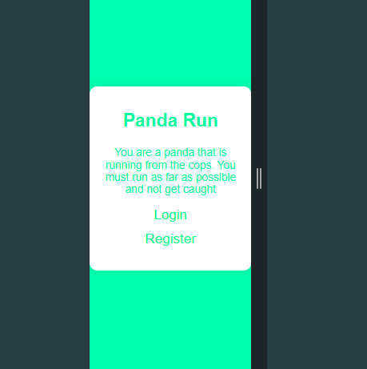
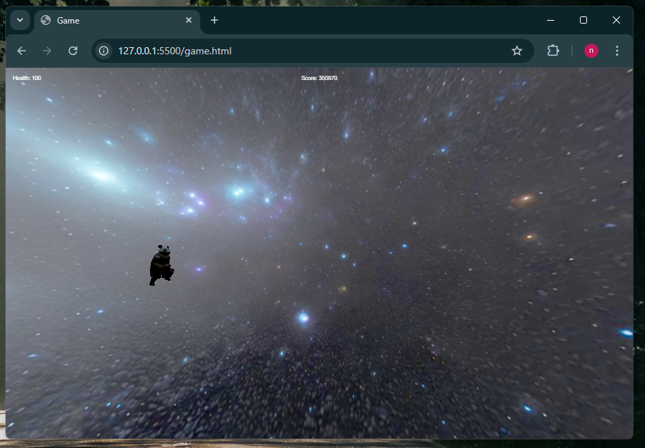
Responsive design
Figure 3.0 Website
Figure 4.0 Game Page

Slide 5
References
https://www.w3schools.com/jsref/met_win_resizeto.asp
https://www.w3schools.com/htmL/html_scripts.asp
https://stackoverflow.com/questions/57258326/when-i-add-my-own-3d-models-to-the-model-viewer-tag-in-html-for-scene-viewer-t
https://www.w3schools.com/js/js_math.asp
https://sketchfab.com/search?q=Panda&type=models

